Slide 1
Phagocytosis
Assist Prof. Rana Adnan

Slide 2
Who discovered phagocytosis?
Ellie Ilya Metchnikoff
discovered it in 1882.
Received Nobel
prize for the same in 1906
Carl Fredrich Claus
coined the term Phagocytosis

Slide 3
what is phagocytosis ?
Phagocytosis is a specific form of endocytosis.
• Phagocytosis (cellular eating) refers to the process of
engulfment and destruction of solid particulate material by
the cells.

Slide 4
What are the cells involved in phagocytosis ?
Professional phagocytes
1.Neutrophils
2.Monocytes
3.Macrophages
4.Dendritic cells
5.Mast cells
6.Eosinophils

Slide 5
What are the cells involved in phagocytosis ?
Non-Professionals
Phagocytosis is not their main function ,
do not have specific receptors.
Lymphocytes
NK (Nutural killer )and LGL cells (Large Granular lymphocytes)
Epithelial cells
Endothelial cells
Fibroblasts

Slide 6
Mechanisms of Action
    Recognition
    Attachment and binding
    Ingestion
    Destruction
    Clearance of phagocytes

Slide 7
Phagocytosis
1) A phagocyte moves towards a group of bacteria, and flows around them.
2) The phagocyte´s cell membrane fuses together, enclosing bacteria in a vacuole.
3) Enzymes are secreted into the vacuole, which digest bacteria.
4) Soluble substances diffuse from the vacuole into the phagocyte´s cytoplasm.

Slide 8
Phases of Phagocytosis
1. Margination
2. Emigration and diapedesis
3. Chemotaxis
4. Opsonization(attachment stage)
5. Engulfment stage
6. Secretion(degranulation stage)
7. Killing or degradation stage

Slide 9
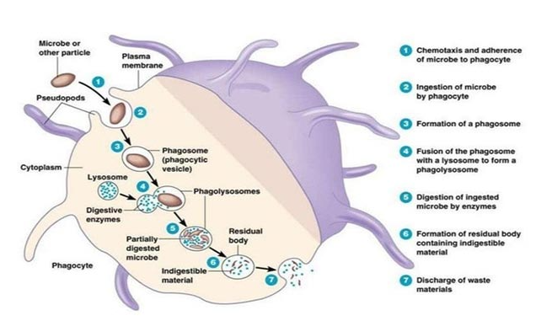

Slide 10
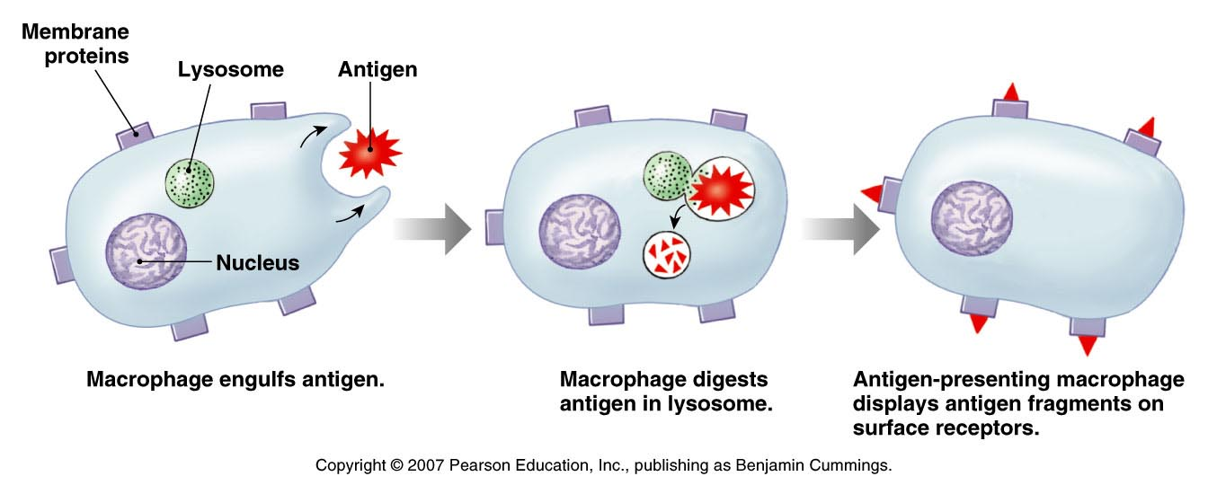
*Phagocytosis and digestión of foreign cell allows macrophates to present antigen
*Lysosomal enzymes digest pathogens that have been enclosed in phagosomes
*Antigen presentation activates lymphocytes

Slide 11
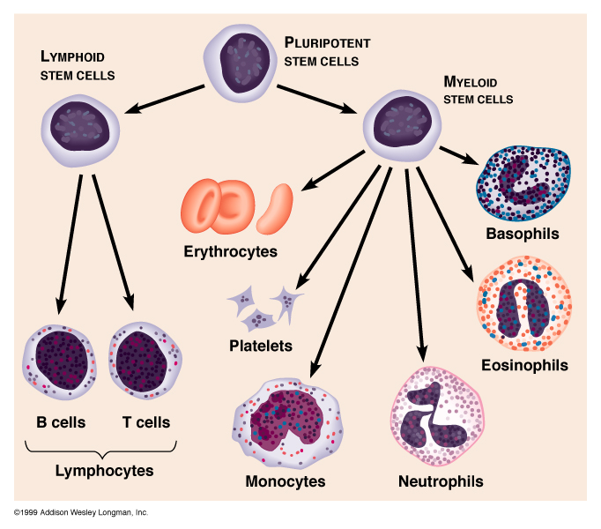
Phagocytic Cells: Macrophages (Monocytes), Neutrophils, and Eosinophils
(Macrophages)

Slide 12
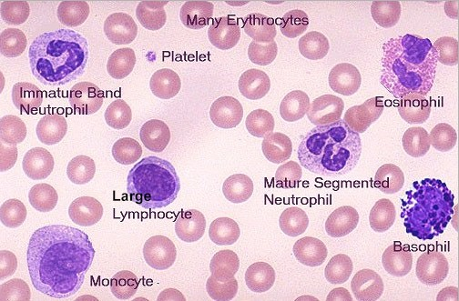

Slide 13
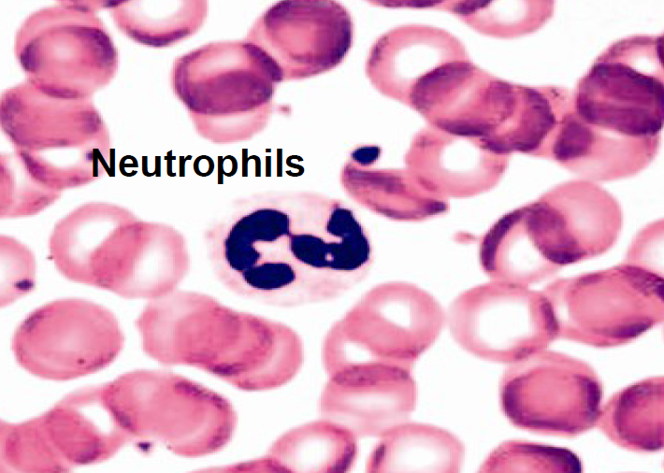

Slide 14
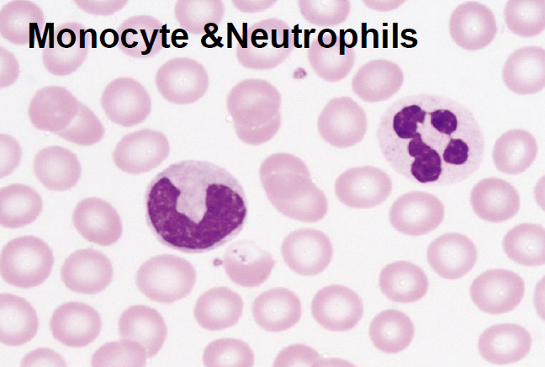

Slide 15
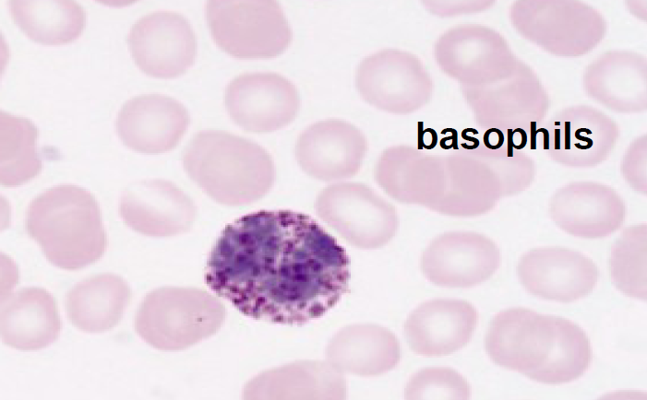

Slide 16
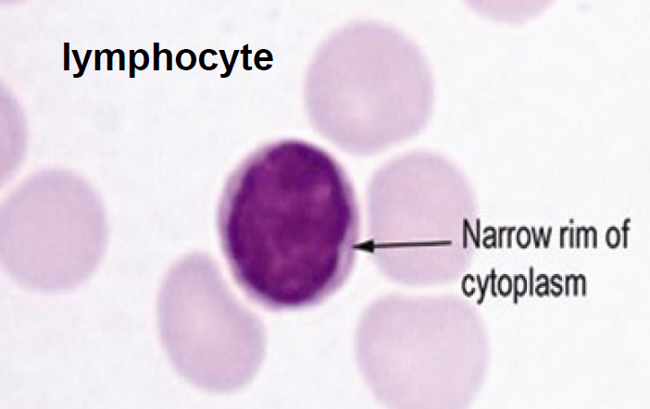

Slide 17
